Slide 1
CS1010S Programming Methodology
Lecture 2
Functional Abstraction
21 Jan 2015

Slide 2
BUGS?
cs1010s-staff@googlegroups.com OR post in Coursemology Forum

Slide 3
Tutorial/ Recitation Scheduling

Slide 4
Late Policy
< 10 min: OK
< 30 min: -10%
< 12 hours: -20%
< 24 hours: -50%
> 24 hours: -100%
Ask early for extensions

Slide 5
Submission is Final
But please remember to click “Submit”

Slide 6
Don’t Stress
But please do your work
Try NOT to submit at 23:58

Slide 7
Variables
Avoid reserved keywords e.g. if
Python convention: lower case letters separated by ‘_’
e.g. count_change
Store memory addresses

Slide 8
Operators
Assignment
a = 5
Equality testing
a == 5
Not equal
a != 5

Slide 9
Backslash \
Escape character
print('That's')
print('That\'s')

Slide 10
#Comments
# this is not a hashtag!
print("Good to go")
#print("Good to go")
# whatever is after the # is ignored
if light == "red": # Check state of light

Slide 11
What's this?
from PIL import *
(Misison 0)
Python Imaging Library

Slide 12
Lecture
LT26
Side Quest
Coursemology
Contest
Coursemology
Training
Coursemology
Forum
Coursemology
Mission
Coursemology
Recitation
Classroom
Tutorial
Classroom
Tutorial Training
Coursemology

Slide 13
Trainings
Please don't anyhow hantam

Slide 14
Computational Thinking

Slide 15
CS1010S Road Map
Memoization
Searching & Sorting
ADVANCED
Dynamic Programming
Object-Oriented Programming
INTERMEDIATE
Higher-Order Procedures
List Processing
Multiple Representations
BASIC
Functional Abstraction
Data Abstraction
Iteration
Mutation & State
Wishful Thinking
Recursion
Order of Growth
Fundamental concepts of computer programming

Slide 16
Functional Abstraction

Slide 17
What is a function?
Function
Inputs
Output

Slide 18




Functions are nothing new
Find x?
$$x=a cos⁡(θ)$$
$$x$$
$$θ$$
$$a$$
input
function

Slide 19
Question:
How do we square a number?

Slide 20
def square(x):
return x * x
Define
Name
Input
Return
Output

Slide 21
441
49
81
square(21)
square(2 + 5)
square(square(3))

Slide 22
def sum_of_squares(x, y):
return square(x) + square(y)
sum_of_squares(3, 4)
25

Slide 23
from math import sqrt
def hypotenuse(a, b):
return sqrt(sum_of_squares(a, b))
hypotenuse(5, 12)
13

Slide 24
General Form
def <name> (<formal parameters>):
<body>
name
Symbol associated with the function
formal parameters
Names used in the body to refer to the arguments of the function
body
The statement(s) to be evaluated
Has to be indented (standard is 4 spaces)
Can return values as output

Slide 25
Black Box
Function
Inputs
Output
Don’t need to know how it works
Just know what it does

Slide 26
Return Type
Function
Inputs
Output
Output is returned with return
Return type can be None

Slide 27
Abstract Environment
Picture Language
(runes.py)
Also graphics.py + image2gif.py

Slide 28
Elements of Programming
Primitives
Means of combination
Means of Abstraction
Controlling Logic

Slide 29

Primitives building block
show(rcross_bb)
Picture object

Slide 30

Primitives building block
show(corner_bb)

Slide 31

Primitives building block
show(sail_bb)

Slide 32

Primitives building block
show(nova_bb)

Slide 33

Primitives building block
show(heart_bb)

Slide 34
Applying operations
op(picture)
Example:
show(heart_bb)

Slide 35
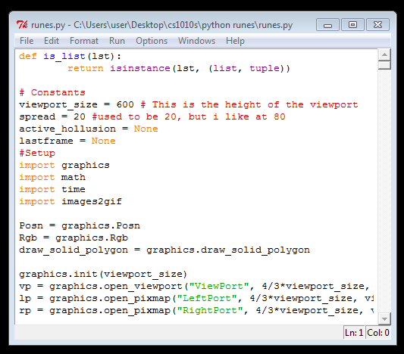
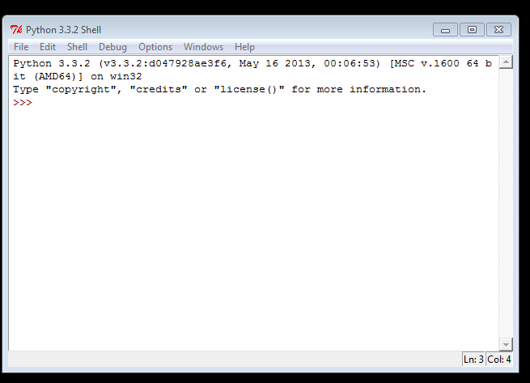
Fun with IDLE
Font matters

Slide 36
Primitive Operation
Rotating to the Right
clear_all()
show(quarter_turn_right(sail_bb))
operation
picture
result is another picture

Slide 37
Derived Operation
Rotating Upside Down
def turn_upside_down(pic):
return quarter_turn_right(
quarter_turn_right(pic))
clear_all()
show(turn_upside_down(sail_bb))

Slide 38
How about
Rotating to the Left?
def quarter_turn_left(pic):
return quarter_turn_right(
quarter_turn_upside_down(pic))
clear_all()
show(quarter_turn_left(sail_bb))

Slide 39

Means of Combination
Stacking
clear_all()
show(stack(rcross_bb, sail_bb))

Slide 40

Multiple Stacking
clear_all()
show(stack(rcross_bb,
stack(rcross_bb,
sail_bb) )

Slide 41
Means of Combination
Placing Beside
def beside(pic1, pic2):
return quarter_turn_right(
stack(quarter_turn_left(pic2),
quarter_turn_left(pic1)))

Slide 42

A complex object
clear_all()
show(
stack(
beside(
quarter_turn_right(rcross_bb),
turn_upside_down(rcross_bb)),
beside(
rcross_bb,
quarter_turn_left(rcross_bb))))
Let's give it a name
make_cross

Slide 43
stack(
beside(
quarter_turn_right(rcross_bb),
turn_upside_down(rcross_bb)),
beside(
rcross_bb,
quarter_turn_left(rcross_bb))))

Slide 44
stack(
beside(
quarter_turn_right(pic),
turn_upside_down(pic)),
beside(
pic,
quarter_turn_left(pic))))

Slide 45
def make_cross(pic):
return stack(
beside(
quarter_turn_right(pic),
turn_upside_down(pic)),
beside(
pic,
quarter_turn_left(pic))))

Slide 46


Naming your objects
clear_all()
my_pic = make_cross(sail_bb)
show(my_pic)
my_pic_2 = make_cross(nova_bb)
show(my_pic_2)

Slide 47
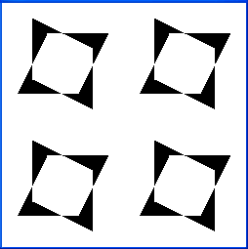
Repeating the pattern
clear_all()
show(make_cross(make_cross(nova_bb)))

Slide 48
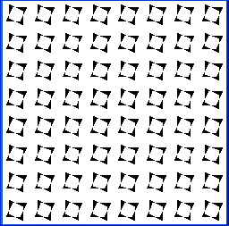
Repeating multiple times
clear_all()
def repeat_pattern(n, pat, pic):
if n == 0:
return pic
else:
return pat(repeat_pattern(n-1, pat, pic))
show(repeat_pattern(4, make_cross, nova_bb))
Qn: What does repeat_pattern return?
recursion

Slide 49

Anonymous Functions
def square(x):
return x * x
foo = lambda x: x * x
foo(1)
foo(4)
input
output
function
1
16

Slide 50
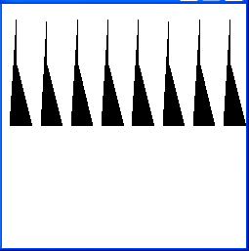
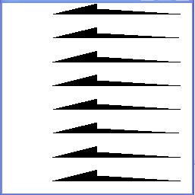
New Patterns
anonymous function
clear_all()
show(repeat_pattern(3,
lambda pic: beside(pic, pic),
nova_bb))
clear_all()
show(repeat_pattern(3,
lambda pic: stack(pic, pic),
nova_bb))

Slide 51

Another nice pattern
clear_all()
show(repeat_pattern(4, make_cross, rcross_bb))

Slide 52


What about 3 rows?
clear_all()
show(stack_frac(1/3, rcross_bb, sail_bb))
clear_all()
show(stack_frac(1/3, rcross_bb,
stack(rcross_bb, rcross_bb)))

Slide 53

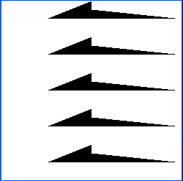
Repeating n times
def stackn(n, pic):
if n == 1:
return pic
else:
return stack_frac(1/n,
pic,
stackn(n-1, pic))
clear_all()
show(stackn(3, nova_bb))
clear_all()
show(stackn(5, nova_bb))

Slide 54
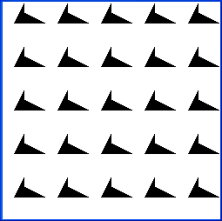
A rectangular quilting pattern
clear_all()
show(stackn(5, quarter_turn_right(
stackn(5, quarter_turn_left(nova_bb)))))

Slide 55

A rectangular quilting proc
def nxn(n, pic):
return stackn(n, quarter_turn_right(
stackn(n, quarter_turn_left(pic))))
clear_all()
show(nxn(3, make_cross(rcross_bb)))

Slide 56
No idea how a picture is represented

Slide 57
No idea how the operations do their work

Slide 58
Yet, we can build complex pictures

Slide 59
Functional Abstraction

Slide 60
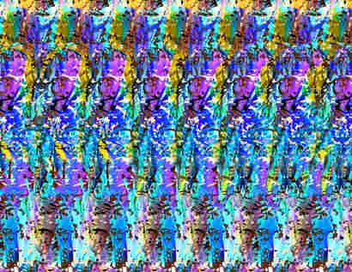
We can make Sterograms!

Slide 61
Black Box
Function
Depth
Map
Sterogram Generator
Inputs
Output
Sterogram
Functional Abstraction

Slide 62
Can't see stereograms?

Slide 63

Anaglyphs

Slide 64
And if you think this is cool…

Slide 65
You ain't seen nothing yet!

Slide 67
What have we learnt?
Functional Abstraction
Functions are objects
(in Python)

Slide 68
Help us manage complexity

Slide 69
Allow us to focus on high-level problem solving

Slide 70
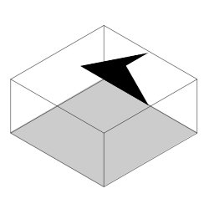

Creating 3D objects
We use greyscale to represent depth
Black is nearest to you
White is furthest away
means

Slide 71


Overlay Operation
clear_all()
show(overlay(sail_bb, rcross_bb))

Slide 72

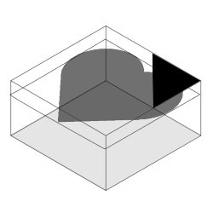
Advanced Overlay Operation
clear_all()
show(overlay_frac(1/4, corner_bb, heart_bb))

Slide 73

Scaling
clear_all()
show(scale(1/2, heart_bb))

Slide 74
Recall
stereogram(scale(1/2, heart_bb))
Function
Depth
Map
Sterogram Generator
Sterogram

Slide 75


Slide 76
Managing Complexity

Slide 77
Computers will follow orders precisely

Slide 78
Abstractions
What makes a good abstraction?
Primitives
Problem
Solution
Abstractions
Invented to make the task easier

Slide 79
Good Abstraction
Makes it more natural to think about tasks and subtasks

Slide 80
Example
House
Bricks
Rooms
Divide and Conquer
Walls
Bricks

Slide 81
Programming
Program
Primitives
Functions
Divide and Conquer
Primitives

Slide 82
Good Abstraction
2. Makes programs easier to understand

Slide 83
Compare:
def hypotenuse(a, b):
return sqrt((a*a) + (b*b))
Versus:
def hypotenuse(a, b):
return sqrt(sum_of_squares(a, b))
def sum_of_squares(x, y):
return square(x) + square(y)
def square(x):
return x * x

Slide 84
Good Abstraction
3. Captures common patterns

Slide 85
stack(
beside(
quarter_turn_right(rcross_bb),
turn_upside_down(rcross_bb)),
beside(
rcross_bb,
quarter_turn_left(rcross_bb))))

Slide 86
stack(
beside(
quarter_turn_right(pic),
turn_upside_down(pic)),
beside(
pic,
quarter_turn_left(pic))))

Slide 87
def make_cross(pic):
return stack(
beside(
quarter_turn_right(pic),
turn_upside_down(pic)),
beside(
pic,
quarter_turn_left(pic))))
Allows Code Reuse

Slide 88
Good Abstraction
4. Allows for code reuse
Function square used in sum_of_squares.
square can also be used in calculating area of circle.

Slide 89
Another Example
Function to calculate area of circle given the radius
pi = 3.14159
def circle_area_from_radius(r): return pi * square(r)
given the diameter:
def circle_area_from_diameter(d): return circle_area_from_radius(d/2)

Slide 90
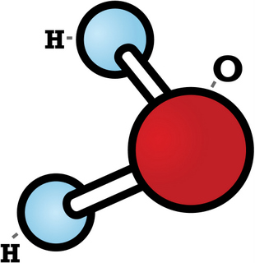
Good Abstraction
5. Hides irrelevant details
Ok for some chemical analyses, inadequate for others.
Water molecule represented as 3 balls

Slide 91
Function
Depth
Map
Sterogram Generator
Sterogram
Function that was provided

Slide 92
Good Abstraction
6. Separates specification from implementation

Slide 93
Recap
Functional Abstraction
=
Black Box
No need to know how a car works to drive it!

Slide 94
Functional Abstraction
Separates specification from implementation
Specification: WHAT
Implementation: HOW

Slide 95
Example
def square(x):
return x * x
def square(x): return exp(double(log(x)))
def double(x): return x + x

Slide 96
To think about
Why would we want to implement a function in different ways?

Slide 97
Good Abstraction
7. Makes debugging (fixing errors) easier
Where is the bug?
def hypotenuse(a, b):
return sqrt(sum_of_squares(a, b))
def sum_of_squares(x, y):
return square(x) + square(y)
def square(x): return x + x
def hypotenuse(a, b):
return sqrt((a + a) * (b + b))

Slide 98
Variable Scope
x = 10
def square(x): return x * x
def double(x): return x + x
def addx(y): return y + x
square(20)
square(x)
addx(5)
Which x ?

Slide 99
Variable Scope
formal parameter
def square(x):
return x * x
body
A function definition binds its formal parameters.
i.e. the formal parameters are visible only inside the definition (body), not outside.

Slide 100
Variable Scope
formal parameter
def square(x):
return x * x
body
Formal parameters are bound variables.
The region where a variable is visible is called the scope of the variable.
Any variable that is not bound is free.

Slide 101
Variable Scope
x = 10
def square(x):
return x * x
def double(x):
return x + x
def addx(y):
return y + x
x is bound
x is bound
y is bound, x is free

Slide 102
Example
pi = 3.14159
def circle_area_from_radius(r): pi = 22/7 #local pi return pi * square(r)
Which pi?

Slide 103
Block Structure
def hypotenuse(a, b):
def sum_of_squares(): return square(a) + square(b)
return math.sqrt(sum_of_squares())
The variables a and b in sum_of_squares refer to the formal parameters of hypotenuse.
Hides irrelevant details (sum_of_squares) from the user of hypotenuse.

Slide 104
Wishful Thinking

Slide 105
Wishful Thinking
Top-down approach:
Pretend you have whatever you need

Slide 106
Example
Suppose you want to compute hypotenuse
def hypotenuse(a, b):
return sqrt(sum_of_squares(a, b))
def sum_of_squares(x, y):
return square(x) + square(y)
def square(x):
return x * x
?
a
b

Slide 107
Another Example
NTUC Comfort, the largest taxi operator in Singapore, determines the taxi fare based on distance traveled as follows:
For the first kilometre or less: $2.40
Every 200 metres thereafter or less up to 10 km: $0.10
Every 150 metres thereafter or less after 10 km: $0.10

Slide 108
Problem:
Write a Python function that computes the taxi fare from distance travelled.

Slide 109
How do we start?

Slide 110
Formulate the problem
Needs a name
Pick an appropriate name
(not foo)
Function

Slide 111
Formulate the problem
Taxi Fare
distance
fare
What data do you need? (be thorough)
Where would you get it? (argument/ computed?)
Results should be unambiguous
What other abstractions may be useful?
Ask the same questions for each abstraction.

Slide 112
How can the result be computed from data?
Try simple examples
Strategize step by step
Write it down and refine

Slide 113
Solution
What to call the function?
What data are required?
Where to get the data?
What is the result?
taxi_fare
distance
function argument
fare

Slide 114
How can the result be computed from data?
e.g. #1: distance = 800 m, fare = $2.40
e.g. #2: distance = 3,300 m
fare = $2.40 + 2300/200 × $0.10
= $3.60
e.g. #3: distance = 14,500 m
fare = $2.40 + 9000/200 × $0.10 + 4500/150 × $0.10 = $9.90

Slide 115
Pseudocode
Case 1: distance <= 1000
fare = $2.40
Case 2: 1000 < distance <= 10,000
fare = $2.40 + $0.10 * (distance – 1000)/200
Case 3: distance > 10,000
fare = $6.90 + $0.10 * (distance – 10,000)/150)
Note: the Python function ceil rounds up its argument. math.ceil(1.5) = 2
What's this?

Slide 116
Solution
def taxi_fare(distance): # distance in metres
if distance <= 1000:
return 2.4
elif distance <= 10000:
return 2.4 + (0.10 * ceil((distance – 1000) / 200))
else:
return 6.9 + (0.10 * ceil((distance – 10000) / 150))
# check: taxi_fare(3300) = 3.6
Can we improve this solution?

Slide 117
Coping with Change
What if…
the starting fare increases?
Stage distance changes?
Increment amount changes?

Slide 118
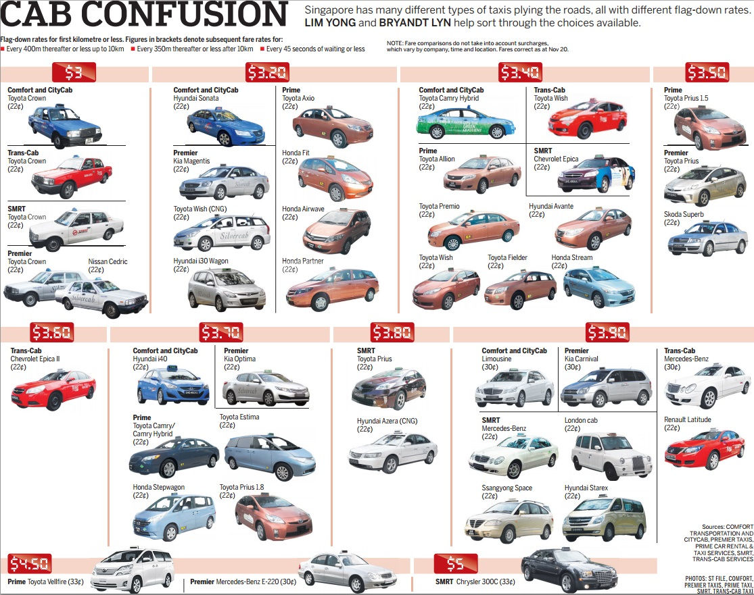

Slide 119
Avoid Magic Numbers
It is a terrible idea to hardcode numbers (magic numbers):
Hard to make changes in future
Define abstractions to hide them!

Slide 120
Solution v2
def taxi_fare(distance): # distance in metres
if distance <= stage1:
return start_fare
elif distance <= stage2:
return start_fare +
(increment * ceil((distance - stage1) / block1))
else:
return taxi_fare(stage2) +
(increment * ceil((distance - stage2) / block2))
stage1 = 1000
stage2 = 10000
start_fare = 2.4
increment = 0.1
block1 = 200
block2 = 150
recsursive call

Slide 121
In 2015
def taxi_fare(distance): # distance in metres
if distance <= stage1:
return start_fare
elif distance <= stage2:
return start_fare +
(increment * ceil((distance - stage1) / block1))
else:
return taxi_fare(stage2) +
(increment * ceil((distance - stage2) / block2))
stage1 = 1000
stage2 = 10000
start_fare = 3.2
increment = 0.22
block1 = 400
block2 = 350

Slide 122
Summary
Functional Abstraction
Good Abstractions
Variable Scoping
Wishful Thinking

